Slide 1

Green Pace
Security Policy Presentation
Developer: Timothy Rainey

Slide 2

OVERVIEW: DEFENSE IN DEPTH
"Defense in depth" is a security strategy that uses multiple layers of security measures to protect information and systems. The idea is that if one layer fails, others will still be in place to thwart an attack.

Slide 3
THREATS MATRIX
Likely (Top-Left Quadrant): Likely but Medium or Low Priority
High Priority (Top-Right Quadrant): Likely and High Priority
Low Priority (Bottom-Left Quadrant): Unlikely and Low Priority
Unlikely (Bottom-Right Quadrant): Unlikely but Medium to High Priority
Likely STD-007-CPP STD-010-CPP | Priority STD-001-CPP STD-003-CPP STD-008-CPP
Low priority [STD-002-CPP STD-005-CPP STD-009-CPP | Unlikely STD-004-CPP STD-006-CPP

Slide 4
10 PRINCIPLES
Validate Input Data
STD-003-CPP
STD-006-CPP
Heed Compiler Warnings
STD-004-CPP
STD-006-CPP
Architect and Design for Security Policies
STD-005-CPP
STD-007-CPP
STD-010-CPP
Keep It Simple
STD-001-CPP
STD-005-CPP
STD-007-CPP
STD-008-CPP
STD-010-CPP
Default Deny
STD-002-CPP
STD-009-CPP
Adhere to the Principle of Least Privilege
STD-002-CPP
STD-008-CPP
Sanitize Data Sent to Other Systems
STD-004-CPP
STD-010-CPP
Practice Defense in Depth
STD-003-CPP
STD-004-CPP
STD-006-CPP
STD-008-CPP
STD-010-CPP
Use Effective Quality Assurance Techniques
STD-003-CPP
STD-004-CPP
STD-005-CPP
STD-006-CPP
STD-007-CPP
STD-008-CPP
STD-010-CPP
Adopt a Secure Coding Standard
STD-004-CPP
STD-006-CLG
STD-007-CPP
STD-009-CPP
STD-008-CPP

Slide 5
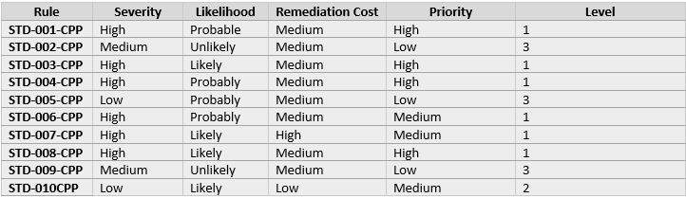
CODING STANDARDS
Items placed in the High Priority would require immediate attention, while those in the Likely but Lower Priority quadrant need to be addressed but are less critical. The Low Priority items should still be on the radar for mitigation, but they do not require immediate action.

Slide 6
ENCRYPTION POLICIES
Encryption in Flight - to ensure that data is not intercepted or tampered with as it travels across networks
Encryption at Rest - protect data stored on any device or media from unauthorized access, especially if the storage medium is lost or stolen.
Encryption in Use - safeguard data actively being processed to prevent unauthorized access and leaks

Slide 7
TRIPLE-A POLICIES
Authentication - confirm the identity of a user, device, or entity before granting access to systems and data.
Systems must enforce authentication before access is granted.
Authorization - authenticated users have appropriate access levels to systems and data based on their roles and responsibilities.
Never give more access to user than necessary
Accounting - track user activities and resource usage for audit purposes
Keep detailed logs of system and user activity

Slide 8
Unit Testing
Do not define a C-style variadic function

Slide 9
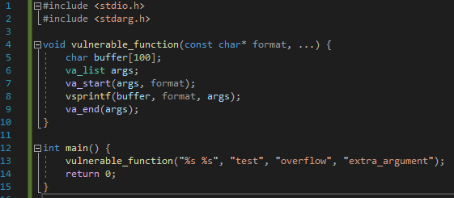
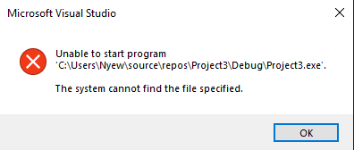
Can we cause a buffer overflow with excess arguments?
Result: The program crashes

Slide 10
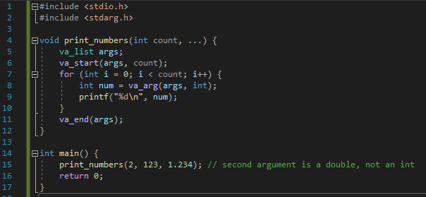
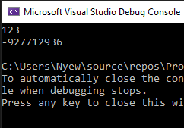
What happens when argument types don’t match?
Result: The output is unpredictable due to type mismatch

Slide 11
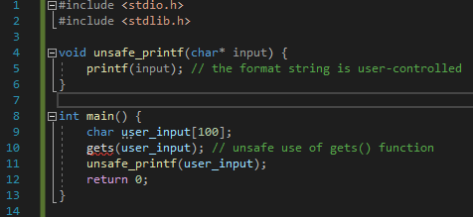
Is the function vulnerable to format string exploits?
Result: The output may reveal memory contents, it could write to memory and cause corruption or crashes

Slide 12
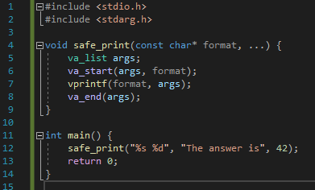
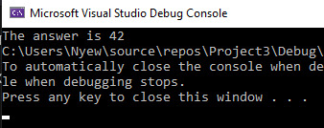
Does the function handle input correctly when used properly?
Result:

Slide 13

AUTOMATION SUMMARY

Slide 14
TOOLS
DevOps
It aims to automate core security tasks by embedding security controls and testing into the development and deployment pipeline
Cppcheck
best used in the Build phase to catch issues early
detects a wide range of code issues including memory leaks, misuses of standard API, and logic errors
Clang
source code analysis tool that finds bugs in C, C++, and Objective-C programs
Ideal during the Verify and Test phase
custom checkers which can be tailored to specific project needs
Parasoft
suite for static code analysis, unit testing, and code review
integrated at multiple points from Build to Pre-production to ensure compliance with coding standards

Slide 15
RISKS AND BENEFITS
Acting Now:
Benefits: Early bug/vulnerability detection, immediate improvement in code quality, proactive risk management.
Risks: Initial cost, learning curve, potential disruption in current workflows.
Waiting:
Benefits: More time to plan, potentially better tool selection as technology evolves.
Risks: Continued vulnerability to undetected bugs, potential for larger issues down the line, higher long-term costs.
Strategic Deficiencies
Overdependence on static analysis.
Insufficient dynamic testing and real-time security monitoring.
Inherent Risks of Strategy
Incomplete detection coverage.
Misinterpretation of tool results leading to ignored critical vulnerabilities.
Steps for Mitigation
Incorporate a mix of static and dynamic analysis tools.
Implement continuous monitoring and incident response protocols.
Conduct regular strategy reviews to refine tooling and processes.
Invest in developer training for maximized tool effectiveness.

Slide 16
RECOMMENDATIONS
Engage ethical hacking services annually to challenge the security measures
Prioritize the integration of security practices from the onset of project development to embed security into the corporate culture
Refined and update as new threats emerge or are identified

Slide 17
CONCLUSIONS
Educate staff on security awareness to reinforce the human element of cybersecurity
Regularly assess and align with emerging industry standards
“No one is safe”

Slide 18
REFERENCES
International Organization for Standardization. (2013). ISO/IEC 27001: Information technology - Security techniques - Information security management systems - Requirements. https://www.iso.org/standard/54534.html
National Institute of Standards and Technology. (2018). Framework for Improving Critical Infrastructure Cybersecurity. https://nvlpubs.nist.gov/nistpubs/CSWP/NIST.CSWP.04162018.pdf
Center for Internet Security. (2021). CIS Benchmarks. https://www.cisecurity.org/cis-benchmarks/
MITRE. (2021). 2021 CWE Top 25 Most Dangerous Software Weaknesses. https://cwe.mitre.org/top25/archive/2021/2021_cwe_top25.html

